Slide 1
SOFTWARE PROCESS & SYSTEM ENGINEERING REKAYASA PERANGKAT LUNAK CSG2J3
by : Tim Pengajar RPL
Teknik Informatika – Telkom University

Slide 2
Outline
Software’s dual role
Fundamental activity of software process
System Engineering
System Engineering Hierarchy
System Modeling
System Engineering Approach
Business Process Engineering
Product Engineering
Example

Slide 3
Software’s Dual Role
Software is a product
Delivers computing potential
Produces, manages, acquires, modifies, displays, or transmits information
Software is a vehicle for delivering a product
Supports or directly provides system functionality
Controls other programs (e.g., an operating system)
Effects communications (e.g., networking software)
Helps build other software (e.g., software tools)
Notes:
Ambil contoh software dari tugas mahasiswa...

Slide 4
Software Characteristic
Software is developed or engineered; it is not manufactured in the classical sense.
The cost of developing software is focused in engineering process, so the software project can’t be managed as in manufacturing project
Software doesn’t “wear out”
Although the industry is moving toward component-based construction, most software continues to be custom built.
a software component should be designed and implemented so that it can be reused.

Slide 5
Software applications
Data processing : telephone billing, pensions
Real time : air traffic control
Embedded systems : digital camera, GPS, iPod
Information systems : web sites, digital libraries
Sensors : weather data
System software : operating systems, compilers
Communications : routers, telephone switches
Offices : word processing, video conferences
Scientific : simulations, weather forecasting
Graphical : film making, design

Slide 6
Software Process
Fundamental Assumption:
Good processes lead to good software
Good processes reduce risk
Good processes enhance visibility

Slide 7
Variety of Software Processes
Software products are very varied...
Therefore, there is no standard process for all software engineering projects
BUT successful software development projects all need to address similar issues.
This creates a number of process steps that must be part of all software projects

Slide 8
Basic Process Steps in all Software Development
Communication
Feasibility and planning
Requirements
System and program design
Implementation and testing
Acceptance testing and release
Operation and maintenance
It is essential to distinguish among these process steps and to be clear which you are are doing at any given moment.
Do not confuse requirements and design
planning
modelling
construction
deployment

Slide 9
Process Step: Feasibility and Planning
A feasibility study precedes the decision to begin a project.
• What is the scope of the proposed project?
• Is the project technically feasible?
• What are the projected benefits?
• What are the costs, timetable?
A feasibility study leads to a decision: go or no-go.

Slide 10
Process Step: Requirements
Requirements define the function of the system from the client's viewpoint.
The requirements establish the system's functionality, constraints and goals by consultation with the client and users.
They are specified in a manner that is understandable by both the client and the development staff.

Slide 11
Process Step: System and Program Design
Design describes the system from the software developers' viewpoint
System design: Match the requirements to hardware or software systems. Establishes an overall system architecture
Program design: Represent the software system functions in a form that can be transformed into one or more executable programs

Slide 12
Process Step: Implementation and Testing
Implementation (coding)
The software design is realized as a set of programs or program units. (The software components may be written specifically, acquired from elsewhere, or modified.)
Testing
Individual components are tested against specifications.
The components are integrated and tested against the design by the development staff as a complete system.

Slide 13
Process Step: Acceptance Testing and Release
Acceptance testing
The system is tested against the requirements by the client.
Delivery and release
The system is delivered to the client and released into production.

Slide 14
Process Step: Operation and Maintenance
Operation: The system is put into practical use.
Maintenance: Errors and problems are identified and fixed.
Evolution: The system evolves over time as requirements change, to add new functions or adapt the technical environment.
Phase out: The system is withdrawn from service.
This is sometimes called the Software Life Cycle

Slide 15
System Engineering
Before SW can be engineered, the “system” in which it resides must be understood
Preliminary Process in developing SW
System Engineering
Software Requirement Analysis
Software Design

Slide 16
System Engineering
System is
a set or arrangement of things so related as to form a unity organic whole
a set of fact, principles, rule, etc, classified in orderly form so as to show a logical plan linking the various part
etc
Computer based system :
A set of arrangement of elements that are organized to accomplish some predefined goal by processing information
Element of Computer based System are :
Software
Hardware
People
Database
Documentation
Procedures

Slide 17
The System Engineering Hierarchy
The process usually begins with a “world view” ➔ the entire business or product domain
The world view is refined to focus more fully on specific domain of interest
The need for targeted system element (with in specific domain) is analyzed
Then Analysis, design, construction of targeted system element is initiated

Slide 18
The Hierarchy

Slide 19
System Modeling
Define the processes that serve the needs of the view under consideration.
Represent the process behavior and the assumptions on which the behavior is modeled.
Explicitly define the exogenous (links between constituents) and endogenous (links between constituent components) input to the model.
Represent all linkages (including outputs) required to understand the view.
*SEPA 6th ed, Roger S. Pressman

Slide 20
System Modeling Factors
Assumption : to reduce variations & permutation
Simplification : to created model an a timely manner
Limitation: to bound the system
Constrains : to guide create model & approach when implement model
Preferences : to indicate architecture for data, function & technology
*SEPA 6th ed, Roger S. Pressman

Slide 21
System Engineering approach
Business Process Engineering
uses an integrated set of procedures, methods, and tools to identify how information systems can best meet the strategic goals of an enterprise
focuses first on the enterprise and then on the business area
Product Engineering
Translate the customer’s desire for a set of defined capabilities into a working product

Slide 22
Business Process Engineering
uses an integrated set of procedures, methods, and tools to identify how information systems can best meet the strategic goals of an enterprise
focuses first on the enterprise and then on the business area
creates enterprise models, data models and process models
creates a framework for better information management distribution, and control

Slide 23
The BPE Hierarchy
Information strategy planning (ISP)
strategic goals defined
success factors/business rules identified
enterprise model created
Business area analysis (BAA)
processes/services modeled
interrelationships of processes and data
Application Engineering
a.k.a ... software engineering
modeling applications/procedures that address (BAA) and constraints of ISP
Construction and delivery
using CASE and 4GTs, testing
Notes:
CASE Computer-Aided Software Engineering

Slide 24
Product Engineering

Slide 25
Product Architecture Template

Slide 26
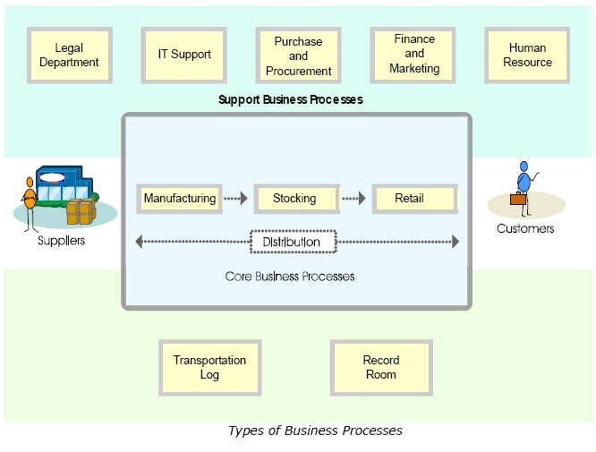
Example

Slide 27
Example (Cont’)
WaterDenims Inc. is a denim trousers manufacturing unit in
North America. It has suppliers and customers spread all across
the world. The movement of a product from the supplier to the
end-customer in the supply chain is as follows:
The order for the raw materials is placed with the supplier.
The raw material from the suppliers arrives at the manufacturing unit, which is located next to the railway station.
The manufacturing unit transforms the material into denim trousers or jeans.
The finished goods are transported to warehouses.
The consignments are dispatched to retail outlets depending on the demand and location.
The goods are transported by ship, trucks, and carry vans.
The consumers buy the denim trousers from the retail outlets.

Slide 28
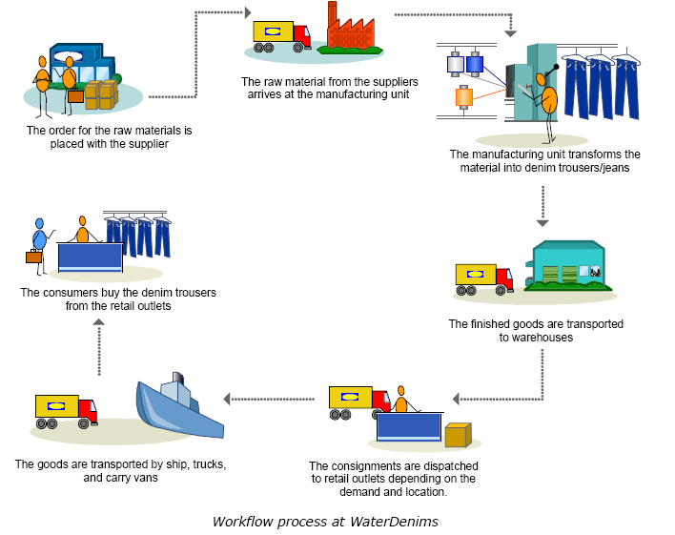
Example (Cont’)

Slide 29
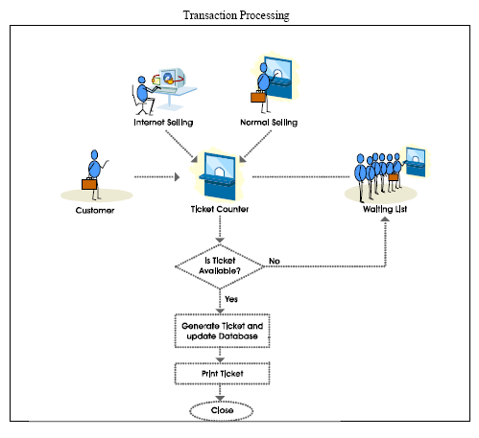
Example (Cont’)
The Flowchart for
the Railways Reservation
Systems

Slide 30
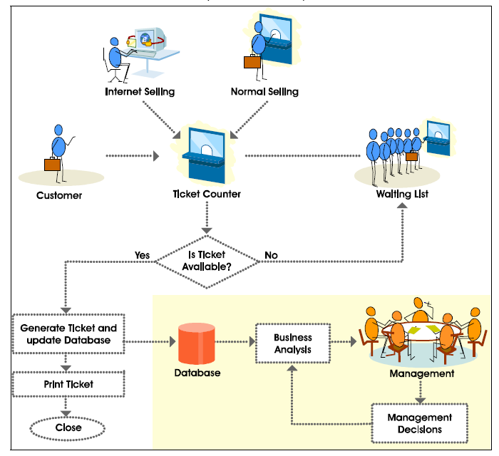
Example (Cont’)
The Flowchart for
the Railways Reservation
Systems

Slide 31
Terima Kasih ....

